Slide 1

Intelli-fitness
using fitted smart data to help you
get a jump on your fitness
by Nicole Kong
Notes:
i want to enjoy my workout and focus on my form, but every time when i workout, i have to spend extra time counting and logging repetitions. So i built a tool that uses my camera to do the job for me. To build the tool….

Slide 2
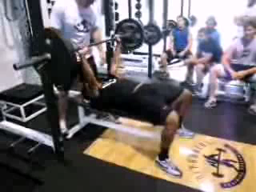
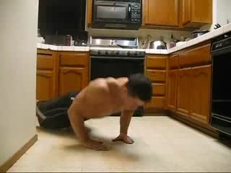
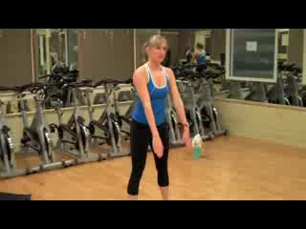
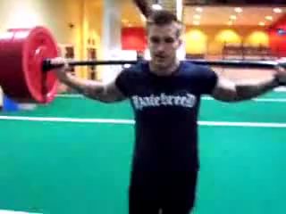
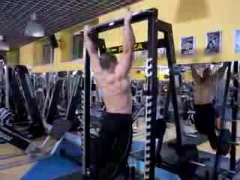
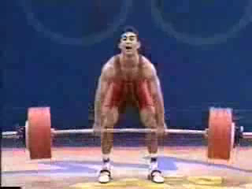
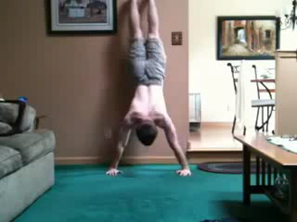
Data
Bench Press
Push Up
Subset of UCF 101 dataset
814 videos
7 exercises
Bodyweight
Squat
Lunge
Pull Up
Clean & Jerk
Handstand
Push Ups
Notes:
I used a subset of UCF 101 action dataset. the subset comprises 814 videos for the 7 exercise classes shown on the slide.
The dataset has a great balance of exercise classes. However, due to the presence of large variations in camera motion, object scale, viewpoint, cluttered background, etc., it is also known a challenging data set.

Slide 3
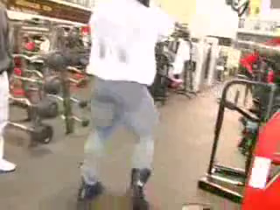
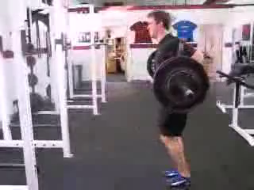
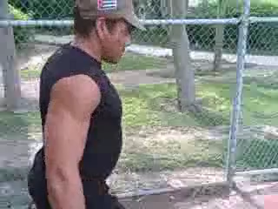
same exercise…
different variations

Slide 4
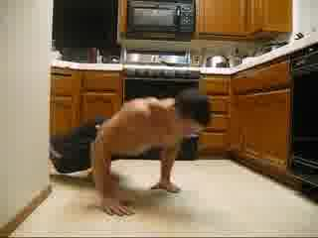
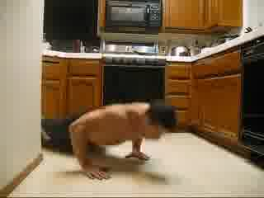
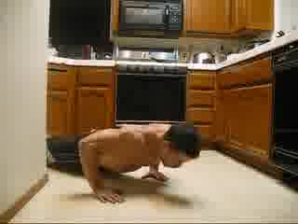
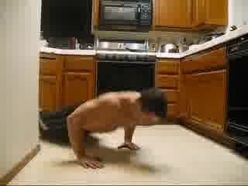
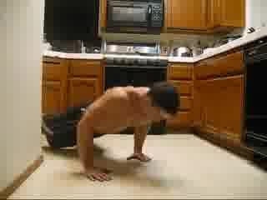
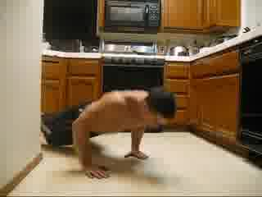
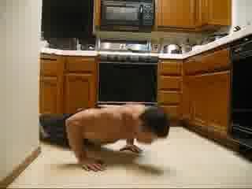
Video Frames Extractions
extracting jpegs of each frame for each video
Notes:
To prepare the data for modelling, first, I converted the videos to series of jpeg images using ffmpeg

Slide 5
Manual Annotation
annotating rep counts per frame for all 814 videos
1
1
1
1
1
2
2
Notes:
then since the number of reps is not available in the dataset, I manually annotated rep counts per frame for all 814 videos

Slide 6
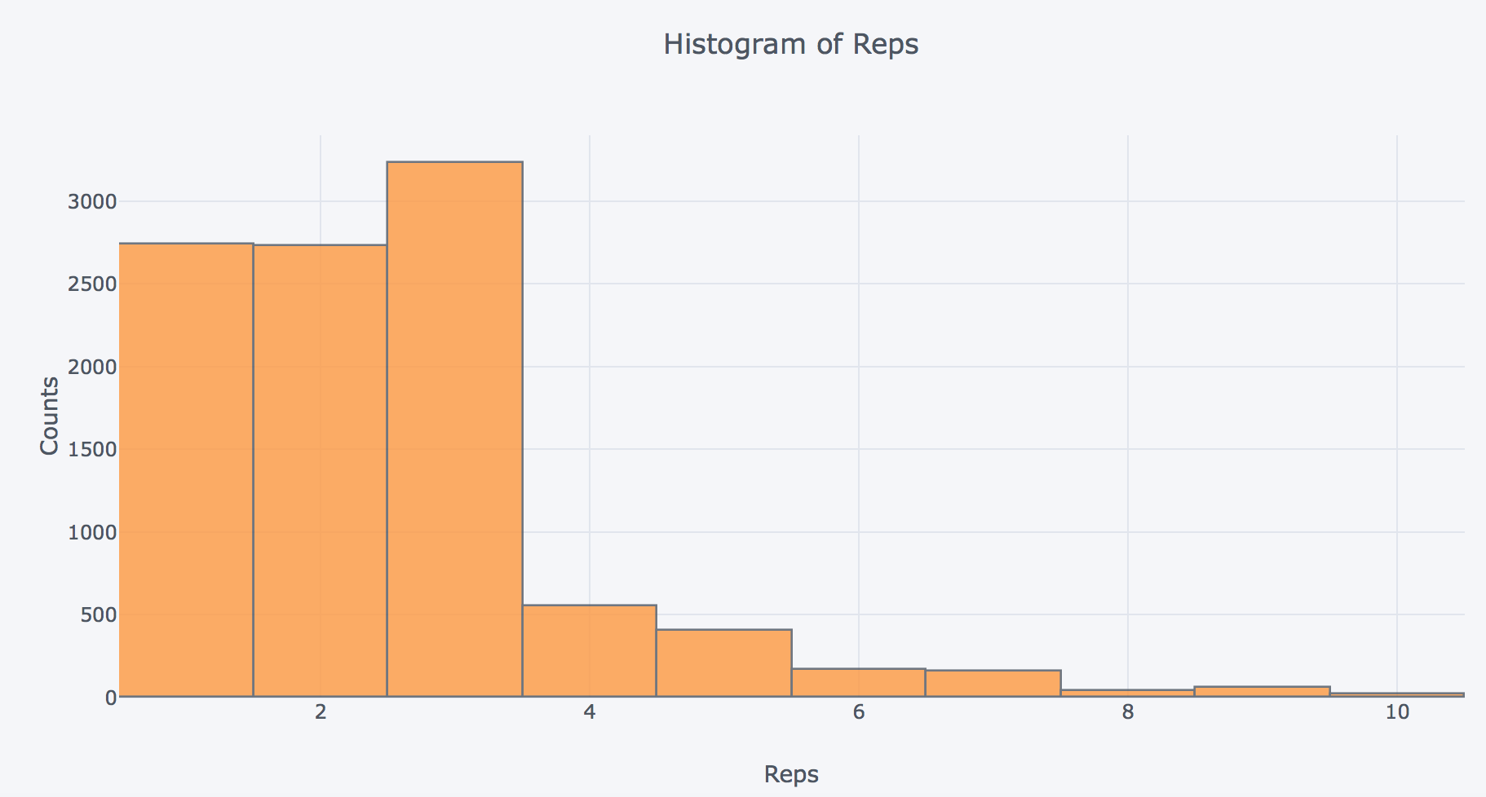
Manual Annotation
range from 1 - 10 reps
Notes:
the videos generally consist of 1 - 3 reps

Slide 7
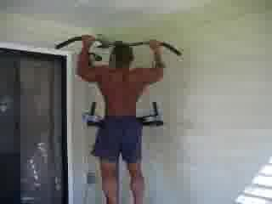
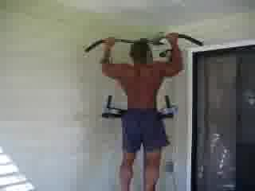
Data Augmentation
perform 11 different image transformations
Transformations
original
Notes:
814 videos are rather small dataset for deep learning models. To get around this, I augmented the dataset by rescaling and flipping the images using Pillow, a python library. This allows me to increase the size of my data 11 times without extra manual annotation.
#Changes in perspective can change the apparent shape of an object. Transparent or reflective objects can also distort objects, but despite this distortion, we know the object to be the same. Affine transformations provide simple linear transforms that can expand a dataset,

Slide 8

Feature Extraction
Classification
Reps Counting
Input Frames
Inception V3
Recurrent Net
Recurrent Net
CNN
Mean Pooling
LSTM
LSTM
1
Modeling
Mean Pooling
1
CNN
LSTM
LSTM
.
.
.
.
.
.
.
.
.
.
.
.
.
.
.
CNN
Mean Pooling
LSTM
LSTM
2
CNN
Mean Pooling
2
LSTM
LSTM
Notes:
After the data preparation, the frames were passed to Inception v3, a google pre-trained CNN model for image classification. instead of taking the classification prediction, I chopped off the the top classification part of the network and took the output from the final pool layer (2,048-d vector of features),
passed them to a single LSTM, a recurrent net that handles sequential data well.
After the LSTM model predicts the exercise class, i then took the classification result and the features extracted from Inception V3 to another LSTM that predicts the count.
#convert those extracted features into sequences of extracted features.
we stitch the sampled 50 frames together
#The LSTM 4096-wide LSTM layer, followed by a 512 Dense layer, with some dropout in between.
#relatively shallow network outperformed all variants

Slide 9
Results

Slide 10
Model
Predictions
Lunges

Slide 11
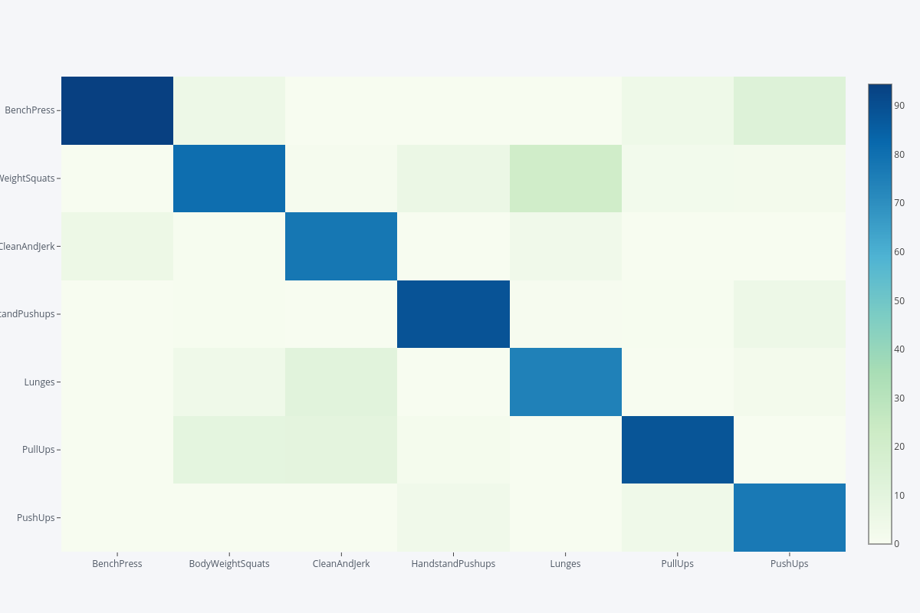
Bench Press
94%
90
80
Classification
Model Results
Body Weight
Squats
81%
70
Clean &
Jerk
78%
60
Actuals
Handstand
Push Ups
89%
50
40
84%
cross-val
accuracy
75%
Lunges
30
Pull Ups
88%
20
10
Push Ups
77%
Bench
Press
Body
Weight
Squats
Clean &
Jerk
Handstand
Push
Ups
Lunges
Pull Ups
Push Ups
Predicts

Slide 12
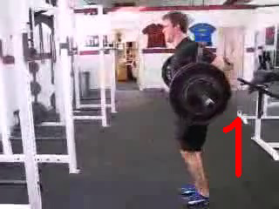
Counting
Model Results
0.51reps
Mean Absolute Error

Slide 13
App

Slide 14
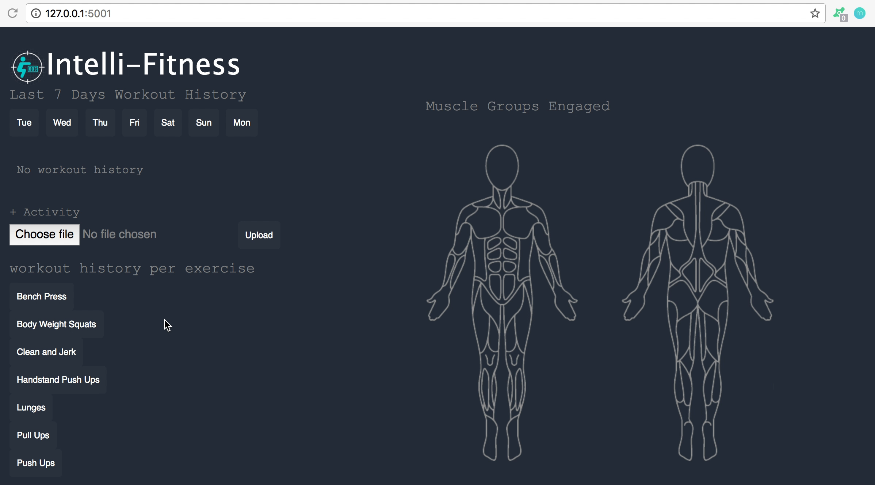

Slide 15
Contact
Info
Nicole Kong
+1 347 636 7719
nicckong@gmail.com
nicckong
nicckong

